Slide 1


Device Identification using wireless technologies
Ryan parkins

Slide 2
Bluetooth low energy (BLE)
Low energy version of Bluetooth, for small amounts of data e.g. sensor data
Usually found in smartwatches and other IOT
2.4GHz Frequency
< 100m Range

Slide 3
Connection handling
Standby - Device is powered off and not transmitting
Advertising - Device is advertising itself out to all nearby devices, it is also listening for responses
Scanning - Device is listening to all packets sent over all channels, used to scan for devices
Initialising - State a central device enters before a connection is established to peripherals (Waiting for connection(s) to be made)

Slide 4


Advertising state
scanning state
A BLE device enters an advertising state whilst it is not connected to a peripheral device and is powered on
Information is transmitted out to any nearby device that is listening (scanning state)
Data transmitted includes
MAC address
Device name
Scanning state listens out for all nearby devices
Can obtain nearby MAC addresses with associated device names

Slide 5

So how can this be of use?

Slide 6

Device presence detection
By using a device in the “scanning” state, we can analyse all nearby advertising data, this means that a list of all nearby MAC addresses can be gathered from a BLE scan

Slide 7

Unique devices
By analysing MAC addresses, not only can the number of devices be seen, but also a record of addresses can be stored
By storing addresses, we can compare MAC’s of nearby devices and those previously seen
This will allow us to differentiate between devices and monitor their presence

Slide 8

Development
Written in python - Linux

Slide 9
Libraries used
Bluetooth (Discovery Service) – Used for performing the BLE scan
Matplotlib – Used to display the results in a live, updating graph

Slide 10

What does this look like in action?

Slide 11
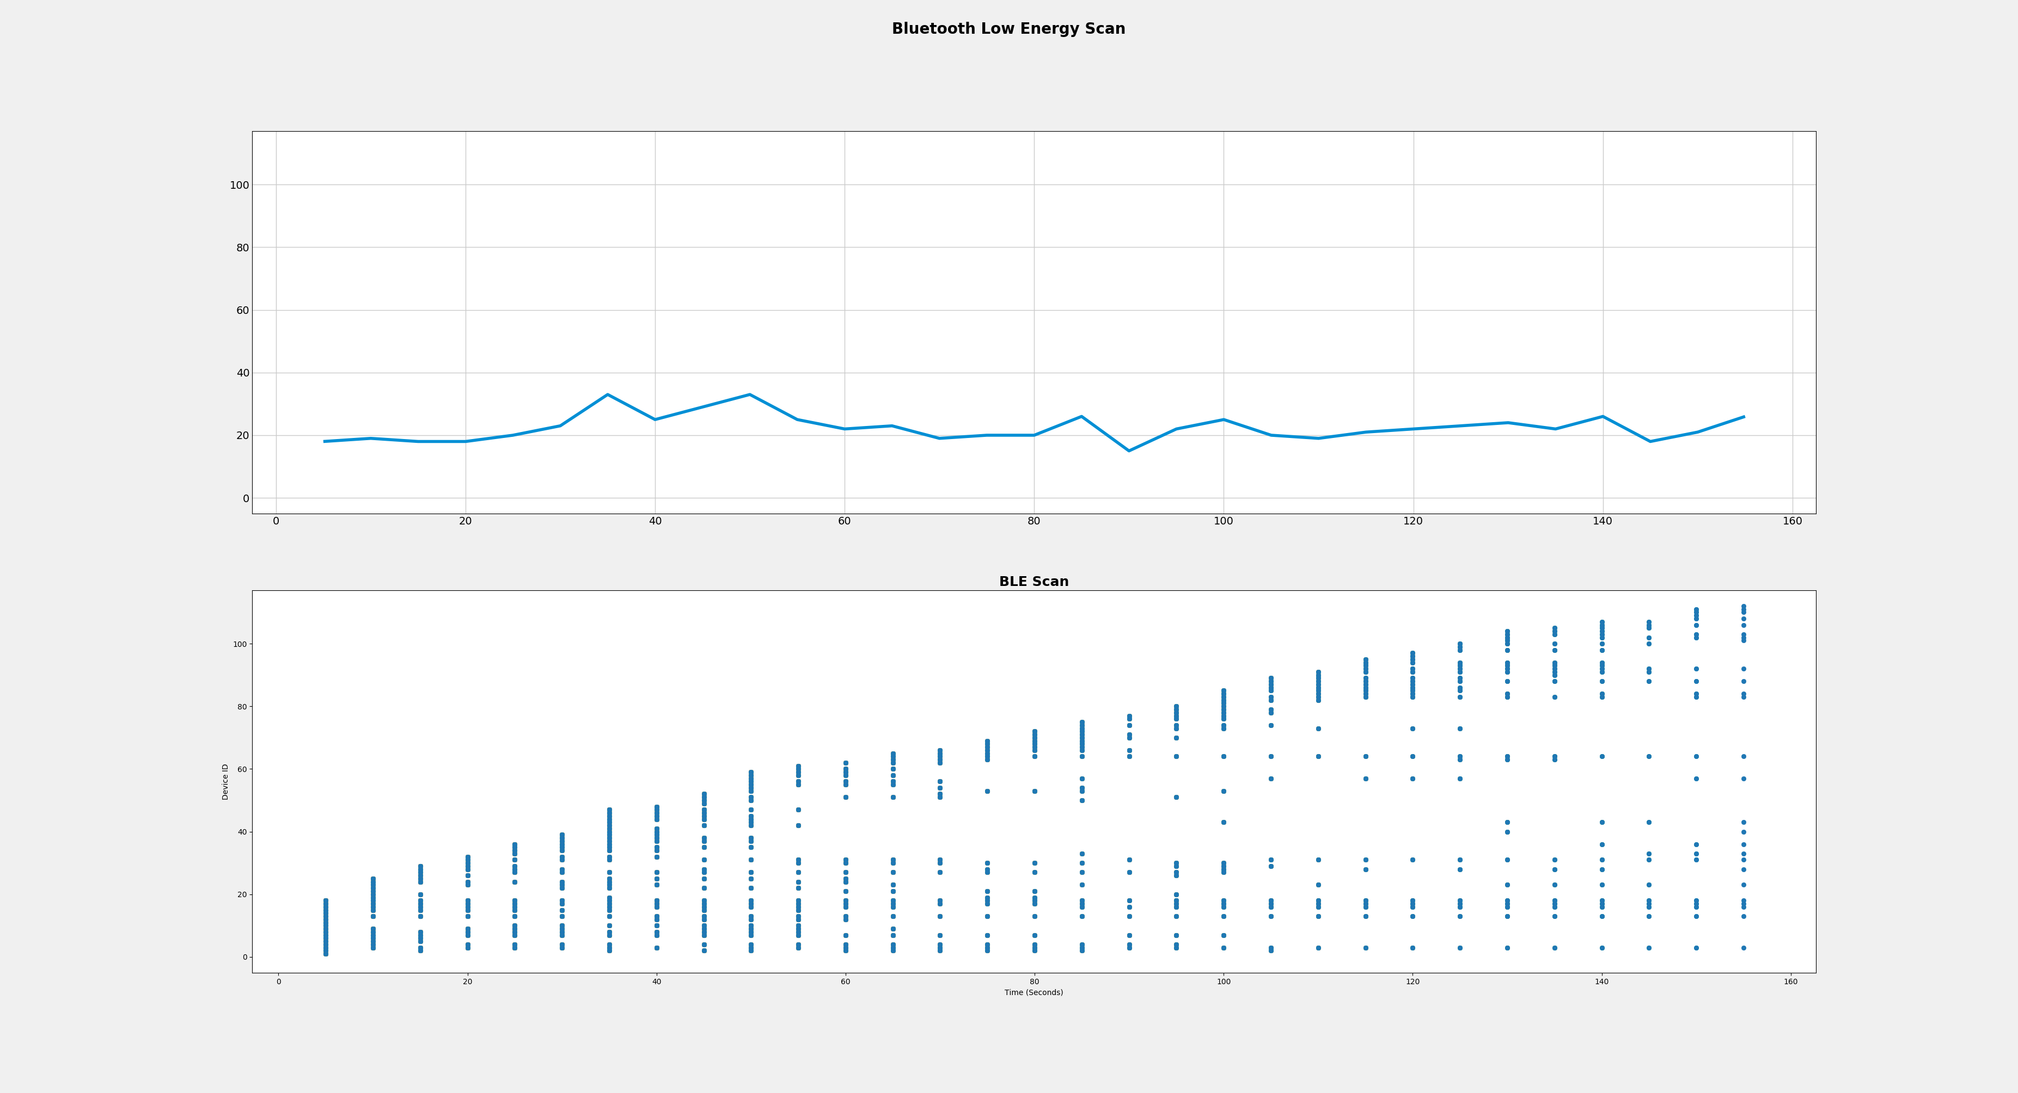
Number of devices in range
Unique devices, Each MAC address given a unique ID
Unique devices, Time in seconds

Slide 12
GitHub repository

